Slide 1

Stars and Mars

Slide 2

Mizar (Zeta Ursae Majoris) Through the Telescope
Mizar is also known as Zeta Ursae Majoris.
When seen through the telescope, Mizar turns out to be not one, but two stars. They are called A and B

Slide 3

Mizar in the Night Sky
Mizar is the middle star of the handle of the Big Dipper, which is actually part of the constellation Ursa Major, the Great Bear.
Big Dipper
Ursa Major
Mizar

Slide 4

Mizar in the Night Sky
If you look closely at the Big Dipper you can see that Mizar has a companion star called Alcor.
Alcor
Mizar
The ability to spot Alcor was traditionally used as an eye test!

Slide 5

Mizar in the Telescope
Mizar and Alcor form a wide trio of stars.
Alcor
Mizar A & B

Slide 6
Binary or Multiple Stars
The distance from Earth to Mizar A & B is about 78 light years.
Mizar A & B are 47 billion miles (345 AU) apart, 11 times the distance between the Sun and Neptune.
Mizar A & B orbit each other every 5,000 years. This makes Mizar a binary star system.

Slide 7
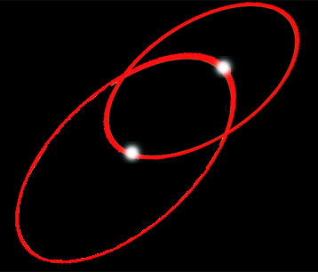

Mizar - Multiple Stars
Mizar A & B are actually each binary stars themselves!
Mizar A
Mizar B
Thus Mizar is a 4 star system

Slide 8
Mizar - Multiple Stars
The two stars of Mizar A are 0.3 AU apart and orbit each other every 20 days.
The two stars of Mizar B are 3 AU apart and orbit each other every 5.7 years.

Slide 9

Multiple-Double
The Mizar system and Alcor are about 3 light years apart - close neighbors but not orbiting each other.
Thus, Mizar-Alcor is an optical double.

Slide 10
Star Pairs
The color of Alcor and the stars of Mizar are blue to white.
They are similar to our Sun, but a bit hotter. They will also have shorter lives.

Slide 11


Star Pairs
Pairs of stars come in two varieties:
Optical Double Stars
Binary Stars

Slide 12

Optical Double Stars
Optical Double stars are just two stars that happen to lie in the same direction in the sky.
(A side view)
If you could see these stars from somewhere in space other than Earth, you would see that they have nothing to do with each other.

Slide 13


Binary or Multiple Stars
In a Binary (or Multiple) star system the stars are relatively close and orbit each other.

Slide 14

Multiple or Optical Double?
It's all in the distance.
Optical double stars are very large distances apart but appear to be close together because they are in the same line-of-sight.
Multiple stars lie close to each other in space and at about the same distance from Earth.

Slide 15
Multiple or Optical Double?
So, how do we get an accurate determination of the distance to “nearby” stars so we can tell if they are true multiples or just optical doubles?
?

Slide 16
How Do We Know the Distance?
Earth
Nearby star
ρ
Background stars
Sun
d
ρ
Apparent positions of the nearby star for observations taken 6 months apart.
From different sides of our orbit around the Sun, the position of a nearby star seems to shift relative to the distant background stars. This shift, called parallax, is used to find the distance to the star.

Slide 17
How Far out is Parallax Accurate?
Earth
Nearby star
ρ
Background stars
Sun
d
ρ
Apparent positions of the nearby star for observations taken 6 months apart.
Using Earth-based telescopes, the parallax method works out to about 60 to 100 light years from Earth.

Slide 18
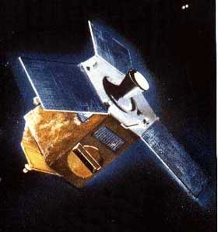
Hipparcos
The Hipparcos satellite was created by the European Space Agency, launched in 1989 and measured parallax to “nearby” stars until 1993 with incredible accuracy.

Slide 19

Hipparcos - Very Accurate!
Hipparcos’ ability to measure angles of paralax was so precise that it could measure the thickness of a dime in New York from Los Angeles!

Slide 20
How Far Is Parallax
Accurate To Now?
With Hipparcos’ new, more accurate parallax measurements we can now accurately measure distances of stars out to several thousand light years!

Slide 21
Distance to Mizar
So Hipparcos was able to directly measure the distances to each of the stars of Mizar, confirming that they are both 78 light years away, and that this a true multiple star system.

